Slide 1
Group 14
Waterfall
6230123921 Thitaree Setwipattanachai
6230252121 Tarm Kalavantavanich
6231301421 Kanokpich Chaiyawan
6231304321 Kittipong Deevee
6231307221 Jirawat Kusalangkurwat
6231333521 Nopdanai Sayamnet
6231353021 Raviporn Akekunanon
6231372021 Atiwat Deepo

Slide 2
MedMyDay
Group 14 Waterfall
Software Engineering II, 2/2021

Slide 3
Contents
01
02
Sprint 1
Recap
Sprint 2 SW demo & Burndown chart
03
04
Sprint 2 Daily Scrum meeting
Sprint 3 Backlog

Slide 4
Sprint 1 Recap
01

Slide 5
Sprint 1 Recap
Delivered whole of the matching system some part of the registration system

Slide 6
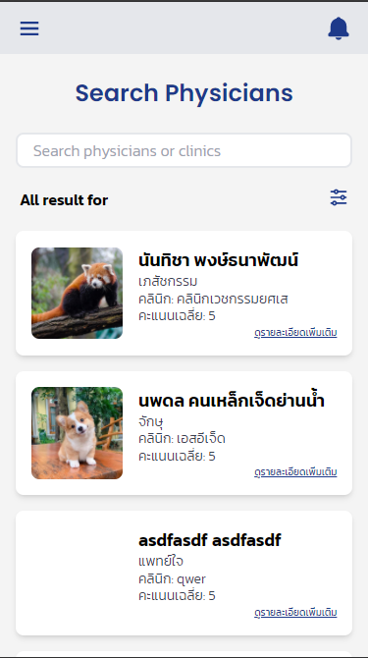
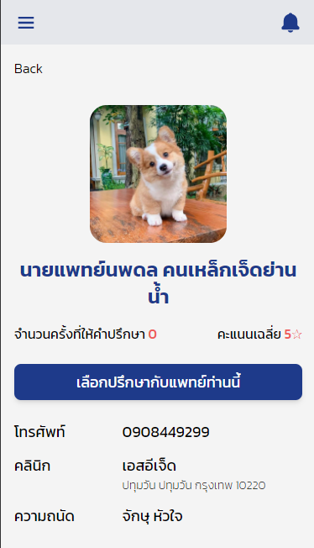
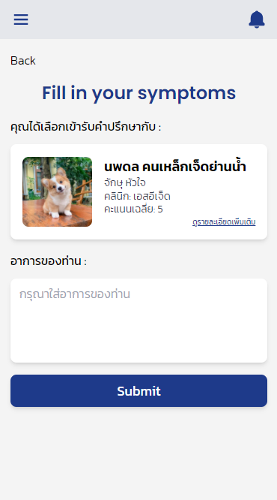
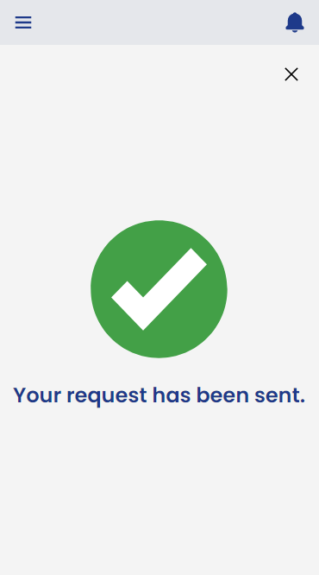
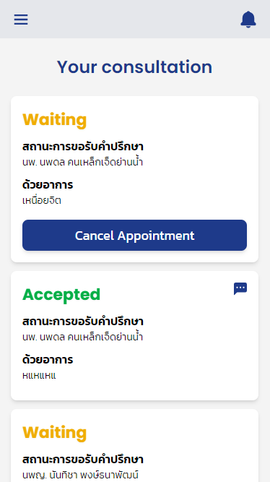
Patient - Request Matching

Slide 7
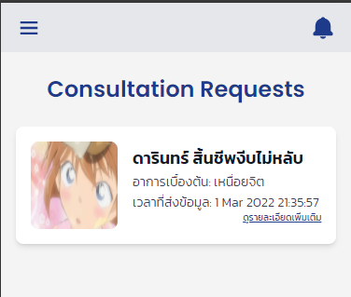
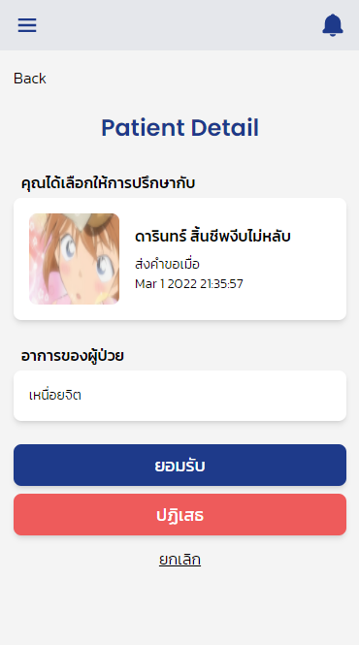
Physician - Consultation requests

Slide 8
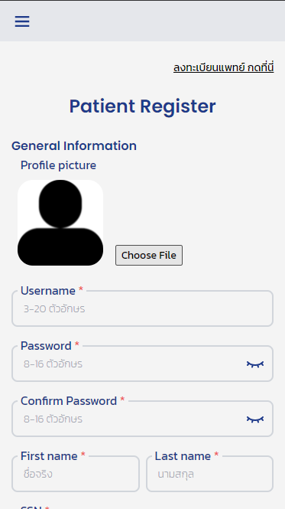
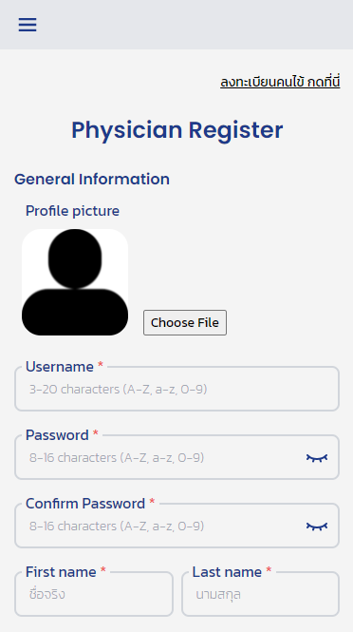
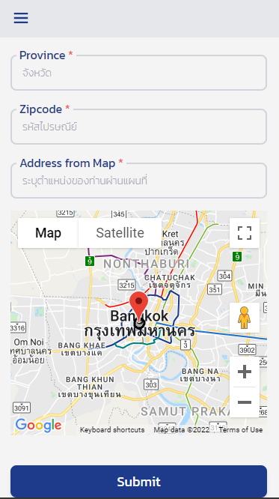
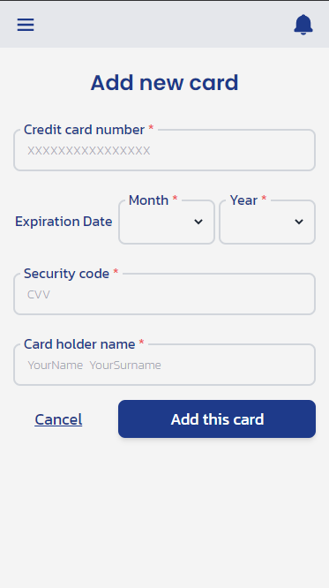

Slide 9
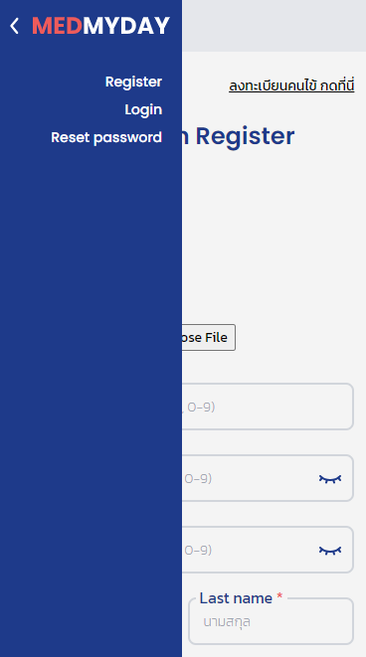
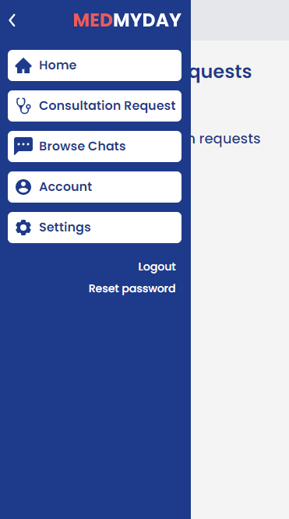
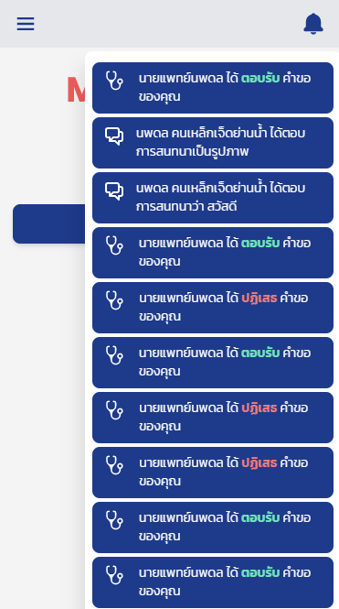

Slide 10
Sprint 2 & Burndown chart
02

Slide 11
Sprint 2 Goal
Deliver the complete login system and the chatting system

Slide 12
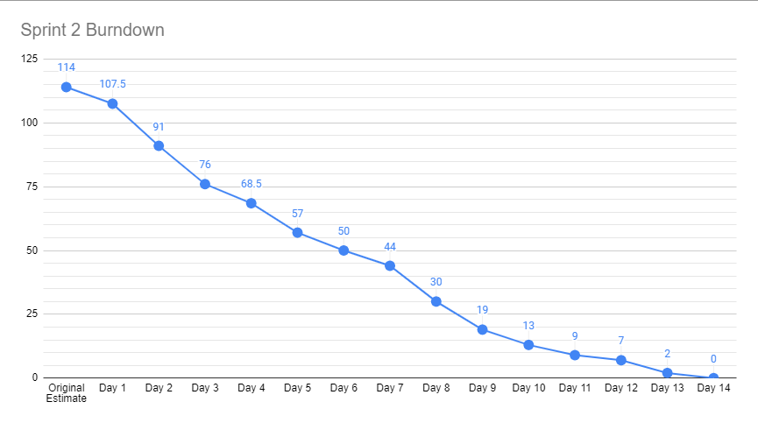
Burndown Chart
Backend ปั่นงานไฟลุก🔥
Frontend ยังทำ Socket ไม่เป็น

Slide 13
DEMO

Slide 14
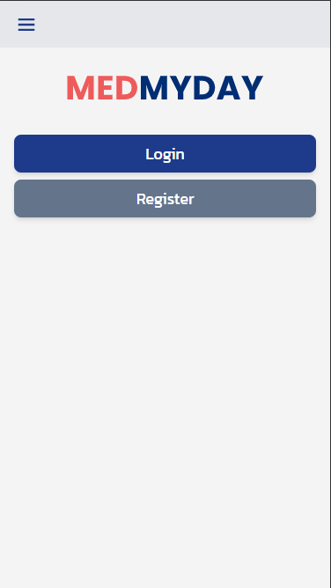
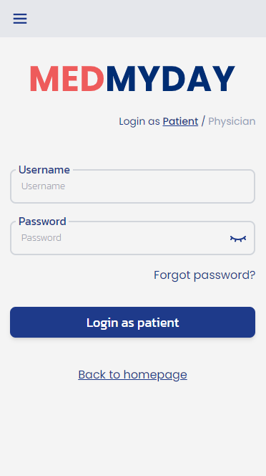
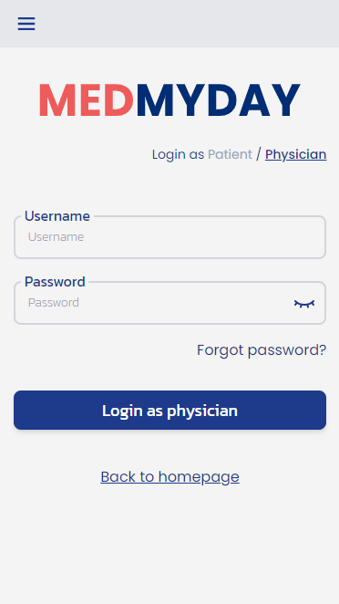
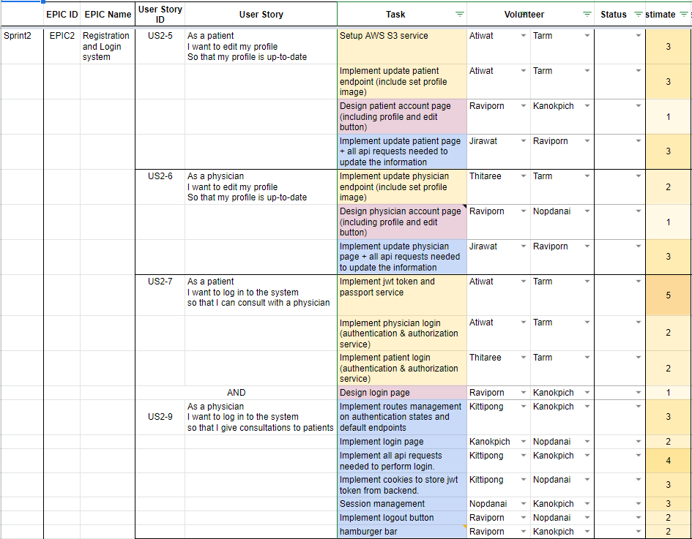
Patient and Physician - Login

Slide 15
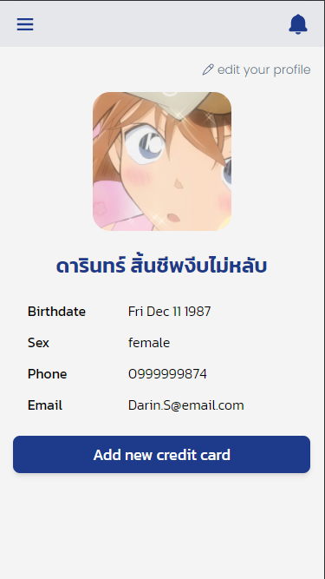
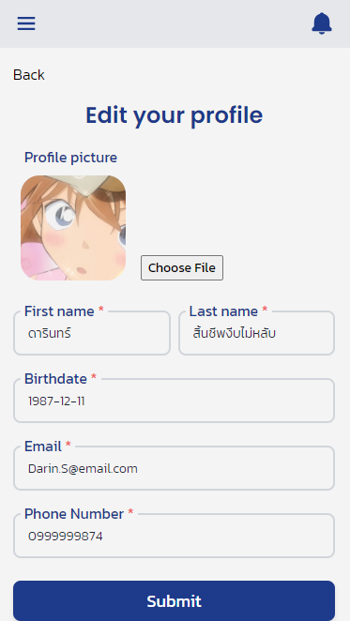

Slide 16
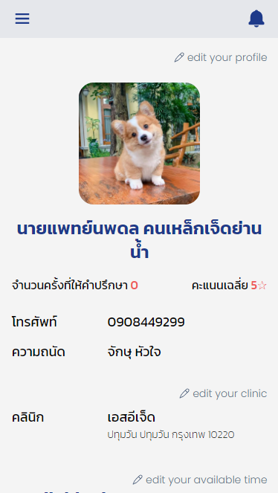
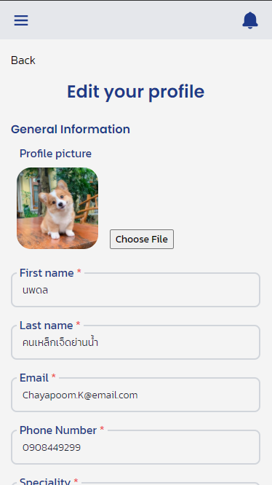
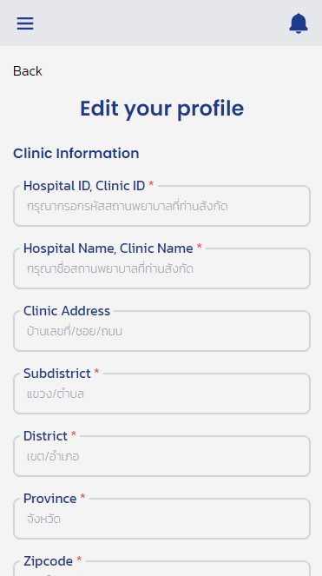
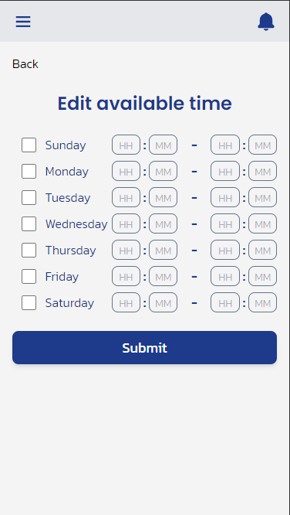

Slide 17
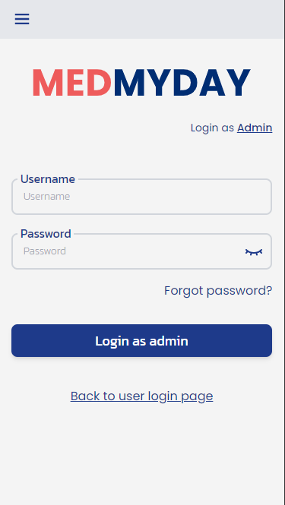
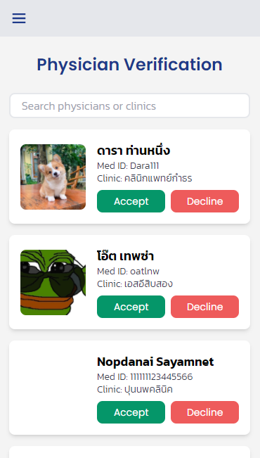
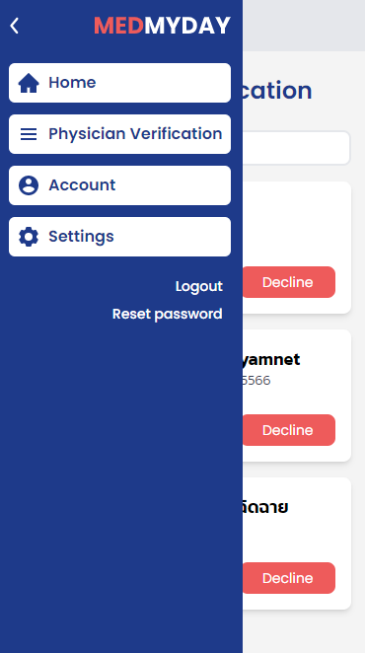
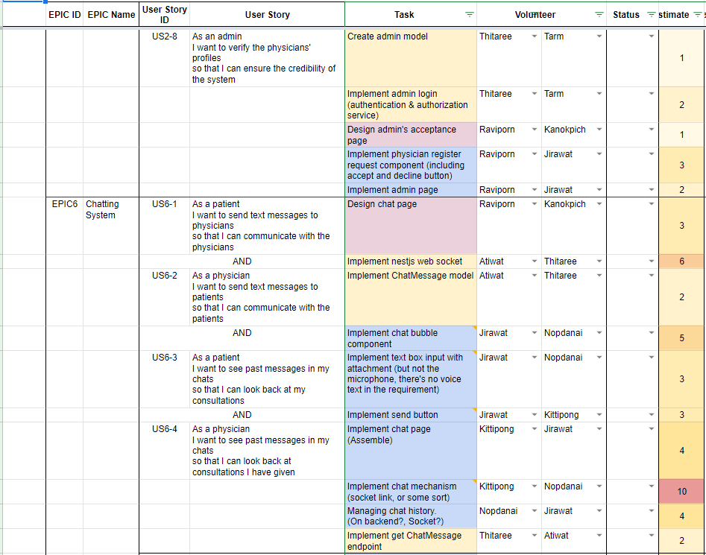
Admin - Physician Verification

Slide 18
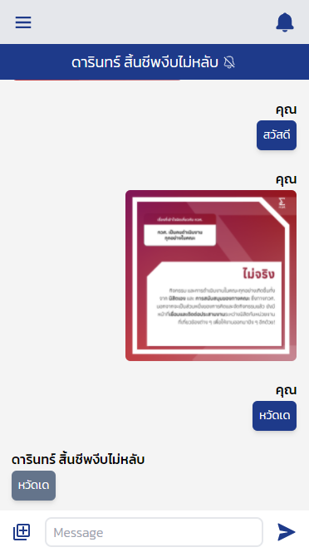
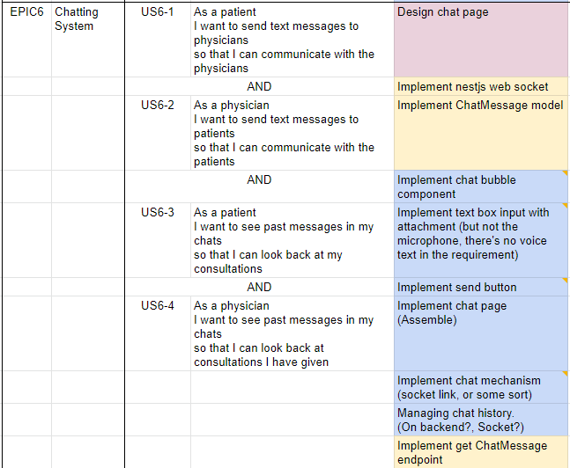

Slide 19
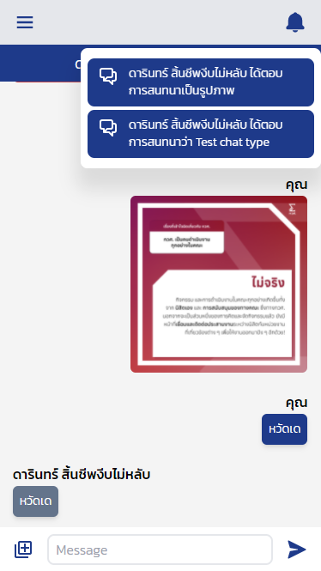
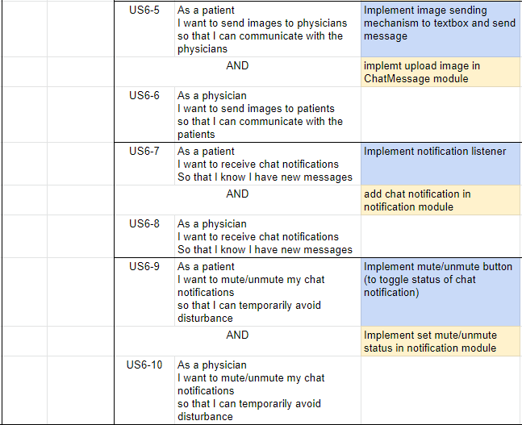

Slide 21
Sprint 2 (Almost) Daily
Scrum meeting
03

Slide 22
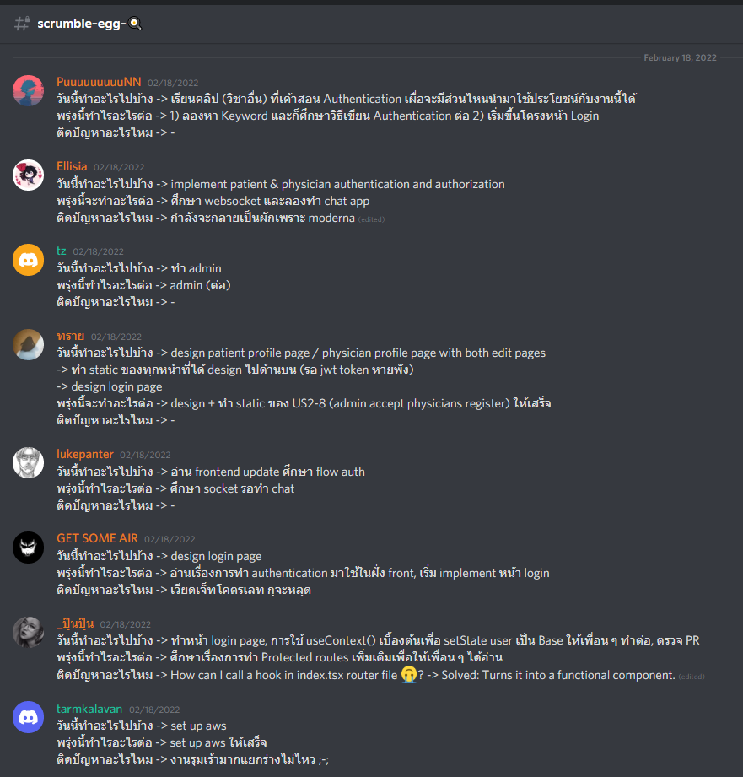
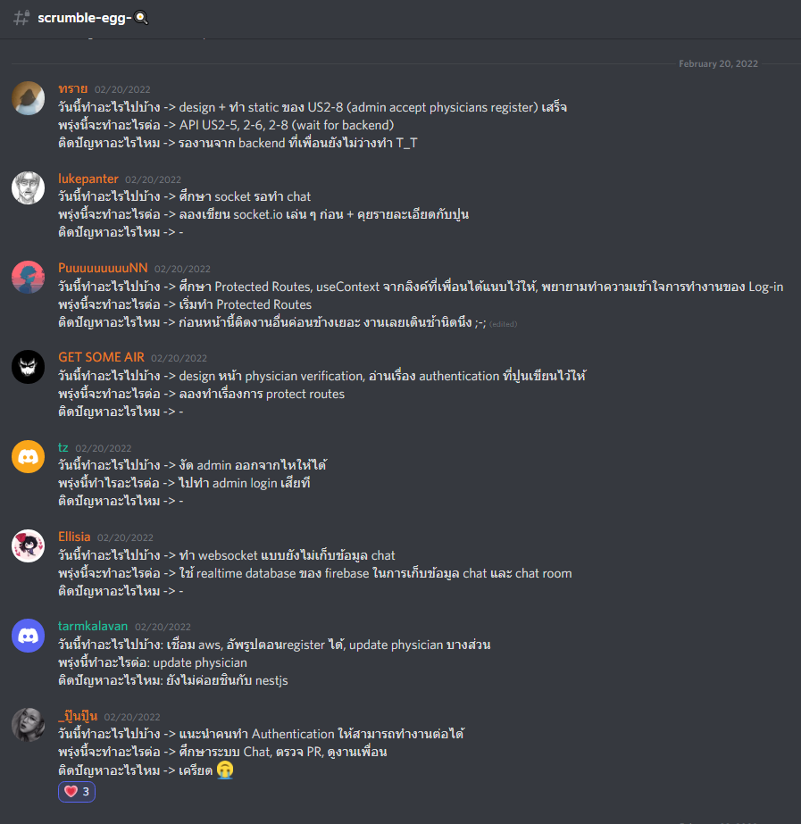

Slide 23
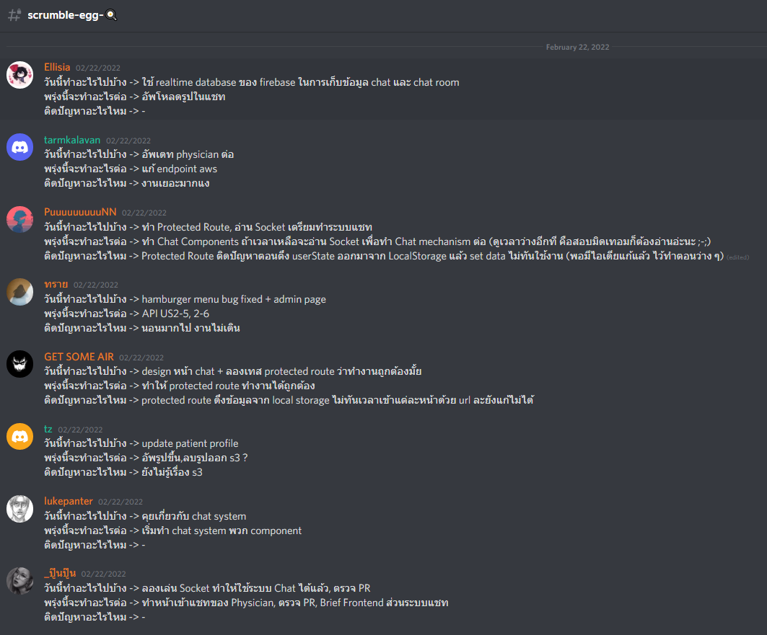

Slide 24
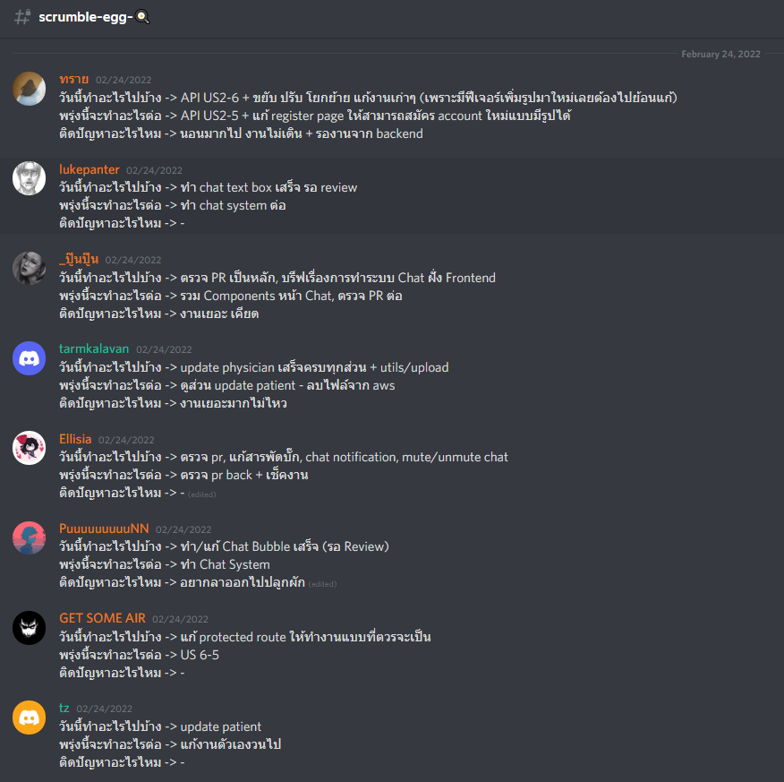

Slide 25
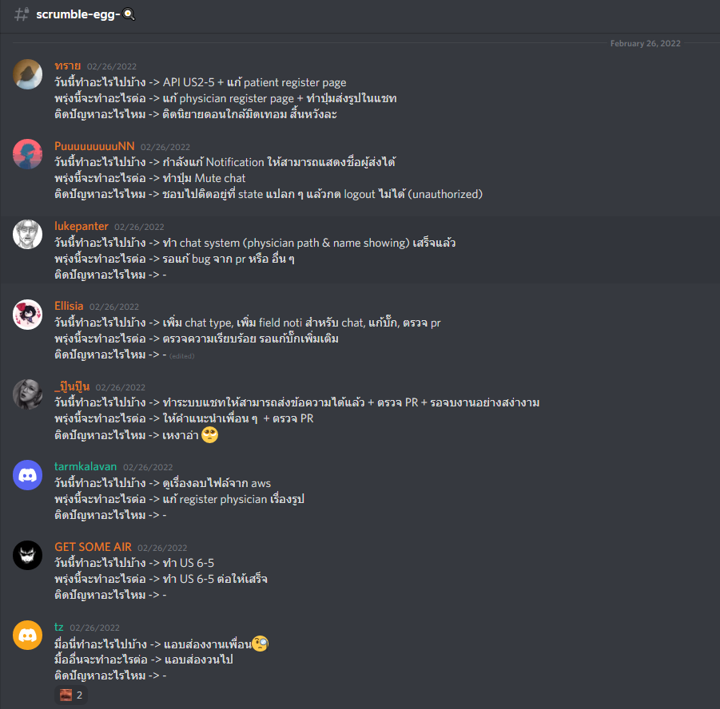

Slide 26
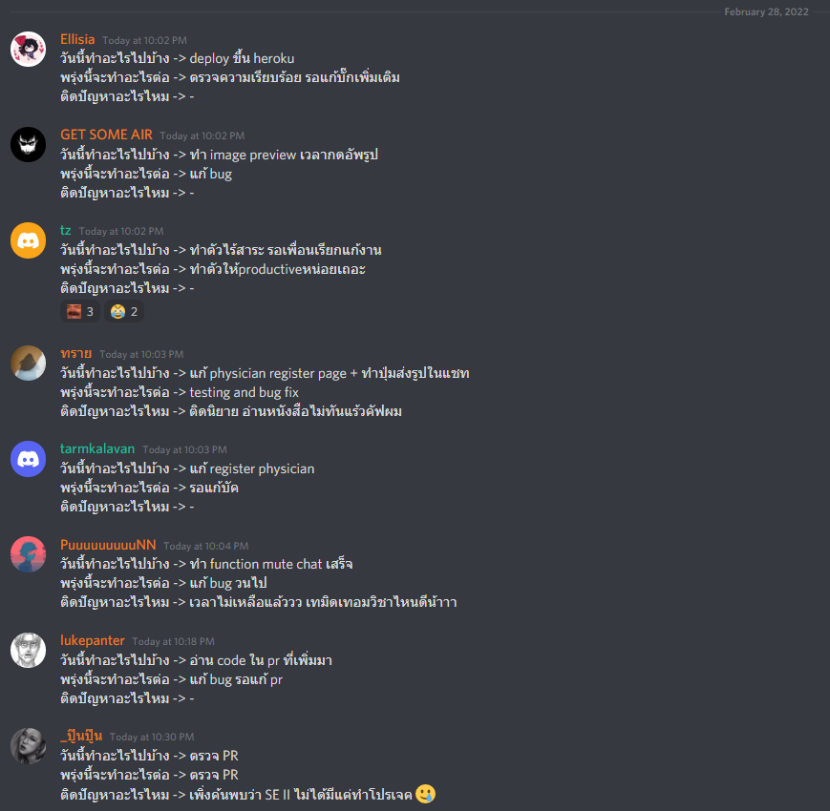





ตัวอย่างของคนทำงานเสร็จ แล้วยังไม่เจอบัค แต่ถึงเจอก็ให้คนอื่นแก้อยู่ดี เยส

Slide 27
Sprint 3 Backlog
04

Slide 28
EPIC
EPIC 1 Matching system
EPIC 2 Registration and Login system
EPIC 3 Video call system
EPIC 4 Payment system
EPIC 5 Rating system
EPIC 6 Chatting system
EPIC 7 Appointment system

Slide 29
Sprint 3 Goal
Deliver the complete video call system, the complete payment system and the complete rating system

Slide 30
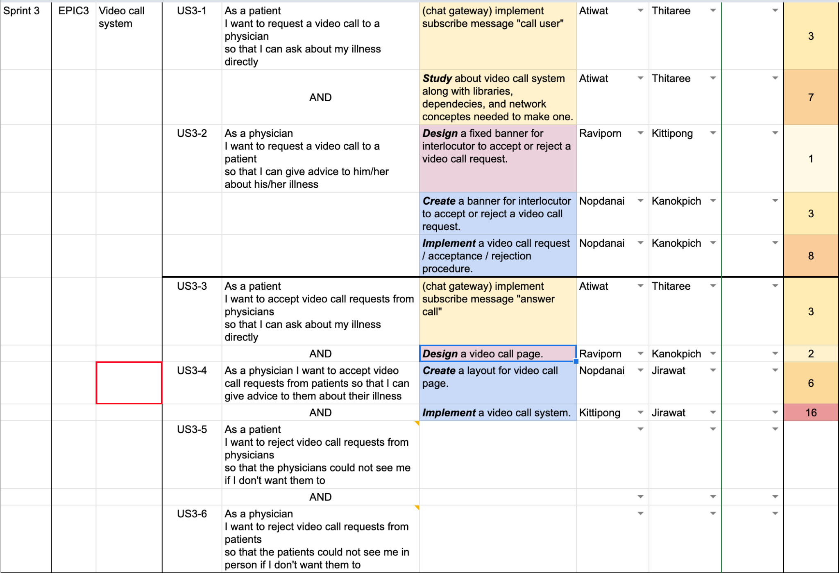
Frontend
Backend
Design

Slide 31
Frontend
Backend
Design

Slide 32
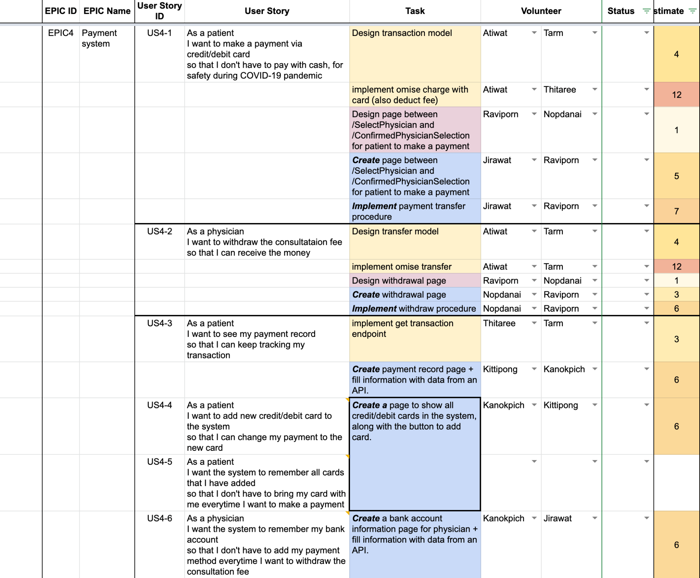
Frontend
Backend
Design

Slide 33
Frontend
Backend
Design

Slide 34
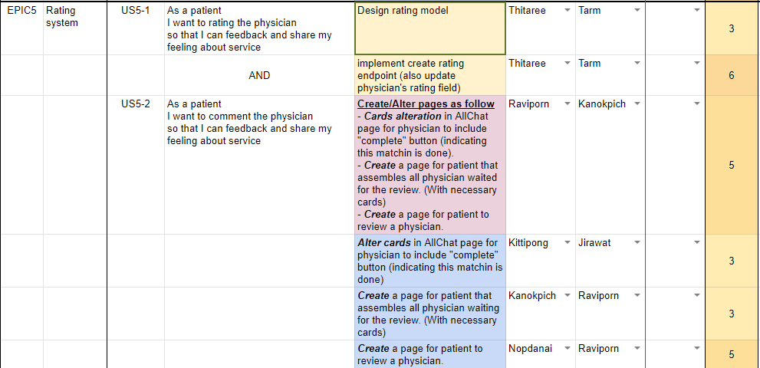
Frontend
Backend
Design

Slide 35
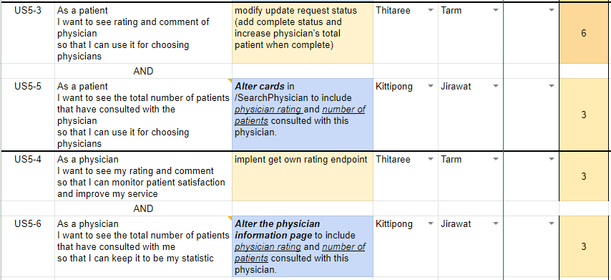
Frontend
Backend
Design

Slide 36
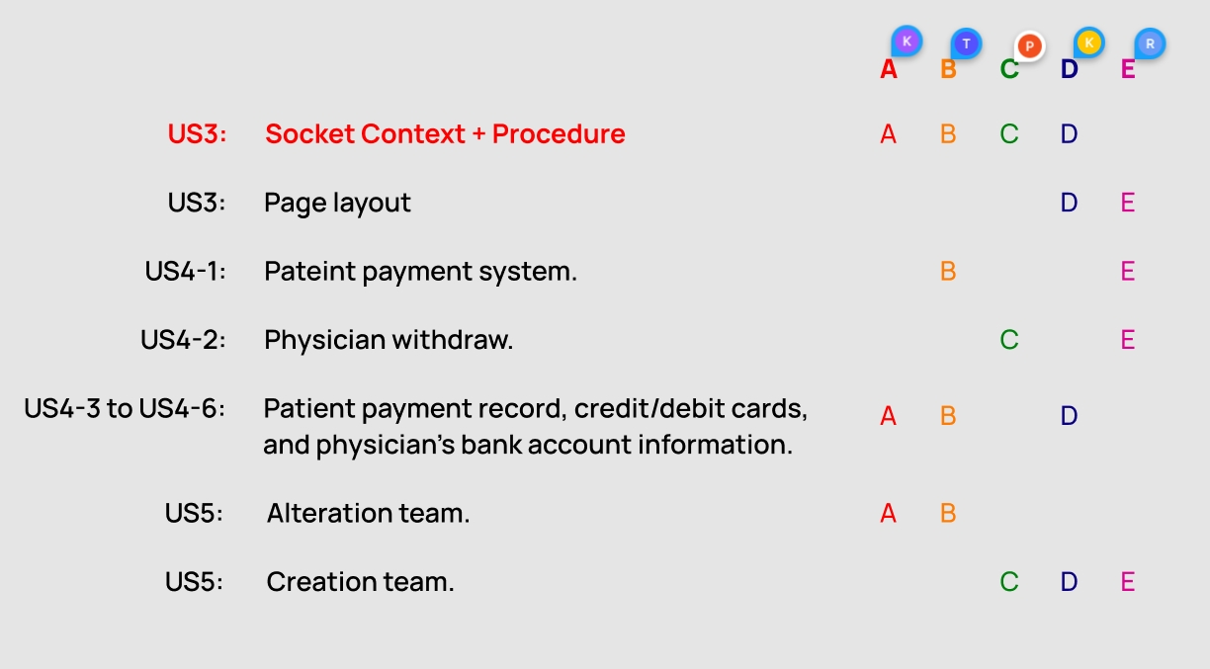
Front-end task delegation

Slide 37
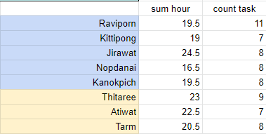
Frontend
Backend

